Slide 1
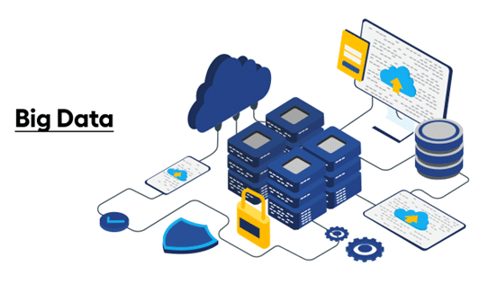
Підготував студент Гапей М.Ю. ПДМ-51

Slide 2

Introduction to Big Data
Big Data is like having a massive amount of complex information that is too big and tricky afor regular computer tools to handle easily.

Slide 3

Why Big Data Matters
Big Data matters because it helps businesses make smart decisions.
It's like a guide that shows companies what's happening, where they can improve, and how they can stay ahead of others.
It's a big deal because it gives a special advantage for success.

Slide 4
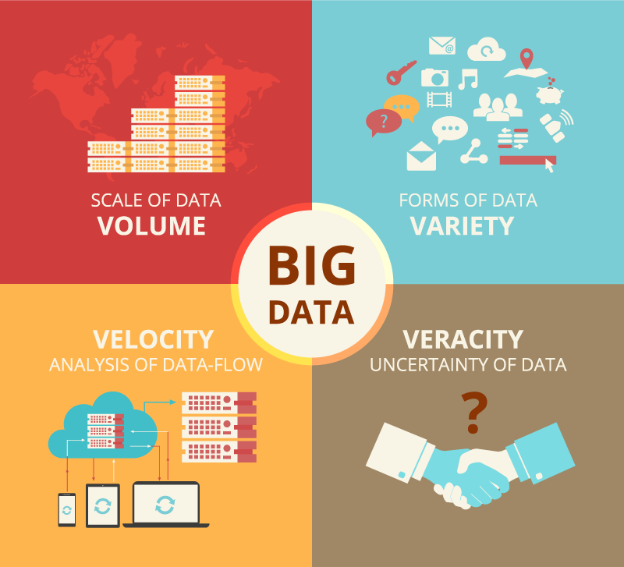
Characteristics of Big Data
Big Data has special features that make it different. There are three main ones:
Volume: It's a lot of data, much more than usual.
Velocity: It comes in fast and needs quick handling.
Variety: It's diverse, with different types of information.
Remembering these three things helps to understand what makes Big Data special.

Slide 5
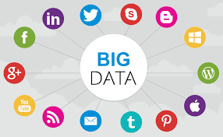
Sources of Big Data
Big Data comes from many places, such as social media, sensors, and records. It's not just from one place - it's a mix of information from all around. Imagine it as a collection of data from various sources, like a big puzzle with pieces from different places.

Slide 6



Big Data Technologies
Big Data Technologies are special tools that help deal with a ton of information. Examples include Hadoop, Spark, and NoSQL databases.

Slide 7

Challenges in Big Data
Big Data encounters challenges in data security, accuracy, and skilled personnel.
It's similar to managing a complex library, ensuring data safety and precision.

Slide 8

Data Processing in Big Data
Data processing in Big Data involves handling a lot of information quickly. It's like managing a fast-flowing river of data, using methods to understand and make sense of it, whether in batches or in real-time.

Slide 9

Real-world Applications
Real-world applications in Big Data involve using extensive data sets to solve practical problems across diverse fields such as healthcare, finance, and manufacturing.

Slide 10

Big Data and Artificial Intelligence
Big Data and Artificial Intelligence (AI) work together. Big Data provides a massive amount of information, and AI uses that data to learn and make smart decisions.

Slide 11

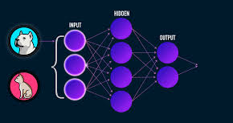
Big Data in Decision-making
Improving Big Data for decisions means easier tools, smarter automation, quicker insights, and secure data.
It involves predicting trends, collaborating, customizing support and continuous learning.

Slide 12
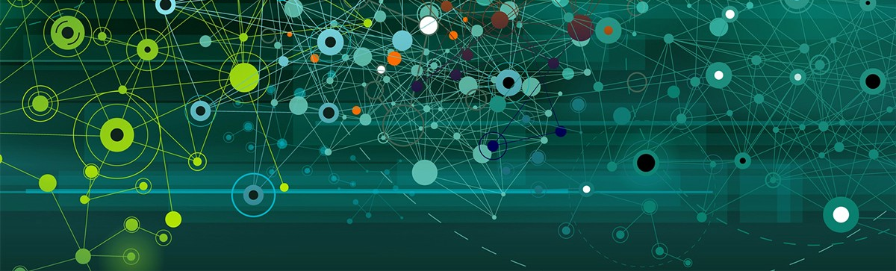
Future Trends in Big Data
Future trends in Big Data include smarter analytics, quicker real-time processing, more AI integration, and a strong emphasis on data security and responsibility.

Slide 13
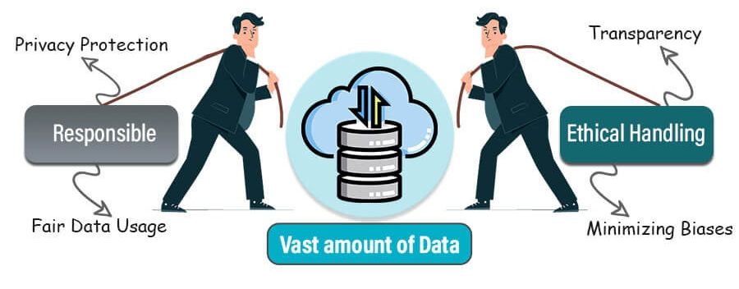
Ethical Considerations
Ethical considerations in Big Data mean making responsible choices about how data is used. It involves ensuring privacy, fairness, and transparency in handling information.

Slide 14
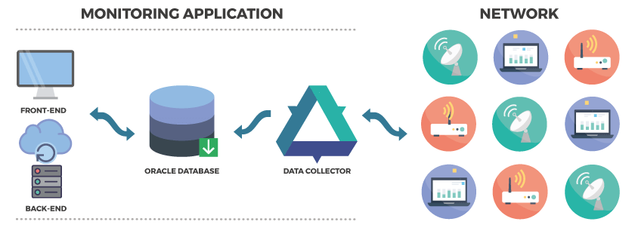
Big Data Implementation Strategy
Implementing Big Data needs a plan. It involves choosing the right tools, setting clear goals, and ensuring data is used wisely. The strategy should adapt as technology evolves, and learning from successes and challenges is key.

Slide 15

Conclusion
Big Data is a powerful tool for smarter decision-making, innovation, and competitiveness. To maximize its benefits, solve challenges, and implement effective strategies.

Slide 16
Thank You for Your Attention!

